Slide 1
Probabilistic Ontology Learner in Semantic Turkey
Francesca Fallucchi, Noemi Scarpato,Armando Stellato,
and Fabio Massimo Zanzotto
ART @ DISP, University “Tor Vergata”
Rome, Italy
{fallucchi,scarpato,stellato,zanzotto}@info.uniroma2.it
AI*IA 2009, Reggio Emilia, December 9-12, 2009.

Slide 2
Outline of the talk
Motivations
Incremental Ontology Learning with Active Learning
Semantic Turkey
Probabilistic Ontology Learner
ST-OL (Semantic Turkey-Ontology Learner)
Conclusions

Slide 3
Motivations
Ontologies and knowledge repositories are important components in Knowledge Representation and Natural Language Processing applications
Learnt Knowledge of Ontology Learning Models cannot be used without validation
Initial Training of Ontology Learning Models is always domain specific
The solution
Incremental Ontology Learning with Active Learning Models
Putting final users in the learning loop for adapting the model
Using a probabilistic ontology learning model that exploits transitive relations for inducing better extraction models

Slide 4
Incremental Ontology Learning
Domain Corpus
Ontology Learner
Initial Ontology
O₀
O_{i}
New Ontologies
Negative Examples
O_{i}

Slide 5
Incremental Ontology Learning
The model
where
M_{C} is the learning model extracted from the corpus
UV is the user validation
O_{i} is the ontology at the step i
O_{i} are the negative examples collected until the step i

Slide 6
Incremental Ontology Learning
For an effective definition of the model we need:
an efficient way to interact with final users
Semantic Turkey
an incremental learning model
A discriminative probabilistic ontology learner

Slide 7
Semantic Turkey
Semantic Turkey is a Knowledge Management and Acquisition system that provide:
(Almost) complete RDFS/OWL Ontology Editor
Integrates inside Firefox most of the typical functionalities of ontology editors like Protégé or TopBraid Composer
Inferential (vs constrained) approach to user interfacing
Extended Bookmarking/Annotation mechanism
Multilingual Annotate & Search support

Slide 8
Semantic Turkey
Extensible rich client platform based on OSGi+Mozilla standards, with :
Redefineable user interface
pluggable Application Services
Interchangeable Ontology Servicing technologies
Putting together different worlds from:
Semantic Annotation
Ontology Development
Web browsing, access and Interaction
to obtain an open framework for Knowledge Acquisition and Management

Slide 9
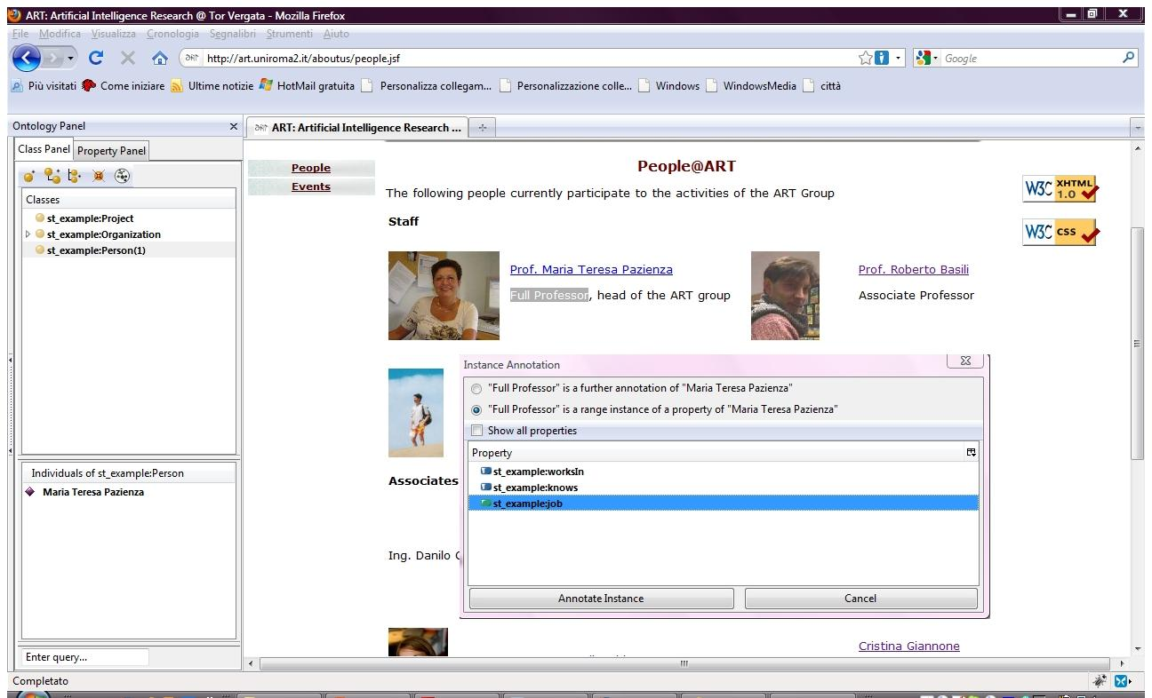
Semantic Turkey

Slide 10
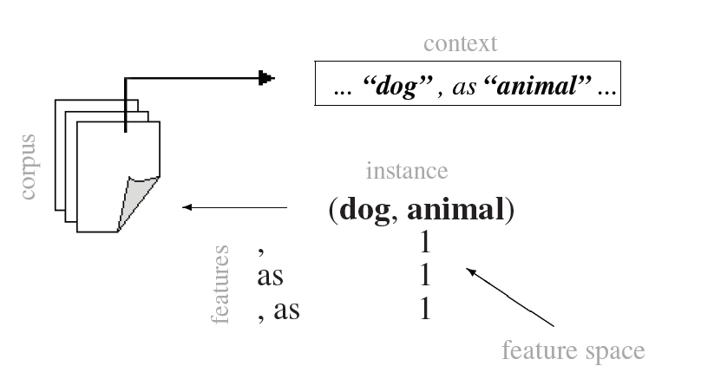
Probabilistic Ontology Learner

Slide 11
Probabilistic Ontology Learner
Without loss of generality, we focus on the isa relation
We compute
P(R_{kj}∈T|E)
where implies that k is a j and E are the evidences collected from the corpus

Slide 12
Probabilistic Ontology Learner
We compute P(R_{kj}∈T|E) using the ontology and the negative examples at the step i
using a discriminative model, i.e., the logistic regression
P(R_{kj}∈T|E)=
where

Slide 13
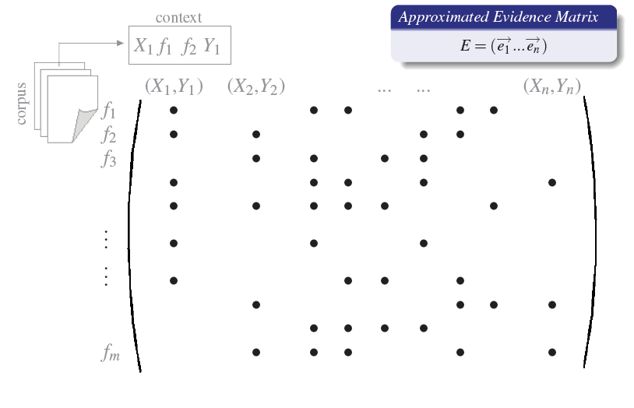
Probabilistic Ontology Learning

Slide 14
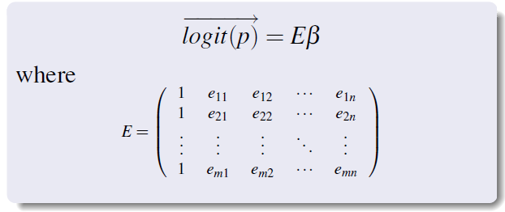
Probabilistic Ontology Learning
We estimate the regressors β₀β₁... β_{k} of x₁…x_{k} with
maximal likelihood estimation
logit(p) = β₀+β₁x₁+... +β_{k}x_{k}
solving a linear problem

Slide 15
Probabilistic Ontology Learner
The matrix E⁺ is the pseudo-inverse of the matrix E of the evidences
p is the vector of the ontology and of the negative examples at the step i
For computing the pseudo-inverse we use Singular Value Decomposition (Fallucchi&Zanzotto, 2009)

Slide 16
Incremental Ontology Learning
Domain Corpus
ST-OL
Ontology Learner
Initial Ontology
O₀
O_{i}
New Ontologies
Negative Examples
O_{i}

Slide 17
Semantic Turkey-Ontology Learner (ST-OL)
Use Semantic Turkey extension mechanism to implement the Ontology Learner Model
Provides a graphical user interface and a human-computer interaction work-flow to supporting the incremental learning loop of our learning theory

Slide 18
Semantic Turkey-Ontology Learner (ST-OL)
The interaction process is achieved through the following steps:
Initialization phase where the user selects the initial ontology O and the bunch of documents C where to extract new knowledge
Iterative phase where the user launch the learning and validates the proposals of ST-OL

Slide 19
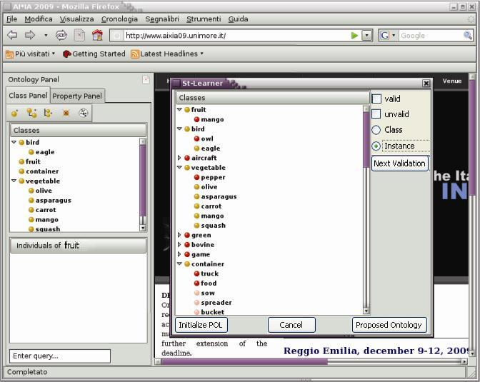
Semantic Turkey-Ontology Learner (ST-OL)
(1)

Slide 20
Conclusions
We presented a system for incremental ontology learning
The model is based on:
The semantic turkey
An Singular Value Decomposition Probabilistic Ontology Learning (Fallucchi&Zanzotto, 2009)
We are working on extending the model to positively taking into account the properties of the considered semantic relations

