Slide 1


Distributed Tree Kernels and Distributional Semantics:
Between Syntactic Structures and
Compositional Distributional Semantics
Fabio Massimo Zanzotto
ART Group
Dipartimento di Ingegneria dell’Impresa
University of Rome ”Tor Vergata”

Slide 2
Prequel

Slide 3
Textual Entailment Recognition
Recognizing Textual Entailment (RTE) is a classification task:
  Given a pair decide if T implies H or T does not implies H
T₂ ⇒ H₂
T₂
“Kesslers team conducted 60,643 face-to-face interviews with adults in 14 countries”
H₂
“Kesslers team interviewed more than 60,000 adults in 14 countries”
In (Dagan et al. 2005), RTE has been proposed as a common semantic task for question-answering, information retreival, machine translation, and summarization.

Slide 4
Learning RTE Classifiers
Training examples
P₁: T₁ ⇒ H₁
P₂: T₂ ⇒ H₂
T₁
“Farmers feed cows animal extracts”
T₂
“They feed dolphins fishs”
H₁
“Cows eat animal extracts”
H₂
“Fishs eat dolphins”
feed → eat
feed → eat
X
Y
X
Y
X
Y
Y
X
Rules with Variables
(First-order rules)
Relevant Features
feed → eat
X
Y
X
Y
P₃: T₃⇒ H₃
Classification
T₃
“Mothers feed babies milk”
H₃
“Babies eat milk”

Slide 5
Feature Spaces of Syntactic Rules with Variables
VP
S
VB
NP
X
NP
Y
→
NP
X
VP
feed
VB
NP
Y
feed → eat
X
Y
X
Y
RTE 2 Results
eat
Rules with Variables
(First-order rules)
Average Precision | Accuracy | First Author (Group)
80.8% | 75.4% | Hickl (LCC)
71.3% | 73.8% | Tatu (LCC)
64.4% | 63.9% | Zanzotto (Milan & Rome)
62.8% | 62.6% | Adams (Dallas)
66.9% | 61.6% | Bos (Rome & Leeds)
Zanzotto&Moschitti, Automatic learning of textual entailments with cross-pair similarities, Coling-ACL, 2006

Slide 6
Adding semantics
Shallow semantics
Learning example
T ⇒ H
T
“For my younger readers, Chapman killed John Lennon more than twenty years ago.”
H
“John Lennon died more than twenty years ago.”
A generalized rule
S
S
NP
VP
→
NP
X
VP
VB
Y
cs
NP
X
VB
Y
cs
killed
causes
died
Variables with Types
Pennacchiotti&Zanzotto, Learning Shallow Semantic Rules for Textual Entailment, Proceeding of RANLP, 2007

Slide 7
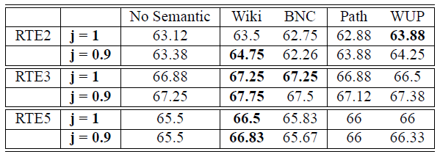
Adding semantics
Distributional Semantics
S
S
NP
VP
→
NP
X
VP
Distributional Semantics
VB
NP
X
VB
killed
died
S
S
NP
VP
→
NP
X
VP
VB
Promising!!!
VB
NP
X
murdered
died
Mehdad, Moschitti, Zanzotto, Syntactic/Semantic Structures for Textual Entailment Recognition, Proceedings of NAACL, 2010

Slide 8
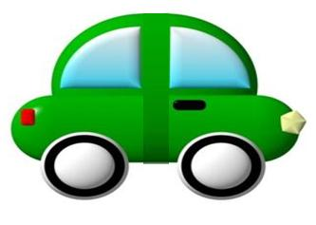

Compositional Distributional Semantics
A “distributional” semantic space
Composing “distributional” meaning
moving car
car
moving
moving hands
hands

Slide 9
Compositional Distributional Semantics
Mitchell&Lapata (2008) propose a general model for bigrams
that assigns a distributional meaning to a sequence of two words “x y”:
  R is the relation between x and y
  K is an external knowledge
x
y
z
moving
hands
moving hands
f

Slide 10
CDS: Additive Model
The general additive model
Matrices A_{R} and B_{R} can be estimated with:
positive examples taken from dictionaries
multivariate regression models
contact /ˈkɒntækt/ [kon-takt]
2. close interaction
Zanzotto, Korkontzelos, Fallucchi, Manandhar, Estimating Linear Models for Compositional Distributional Semantics, Proceedings of the 23rd COLING, 2010

Slide 11


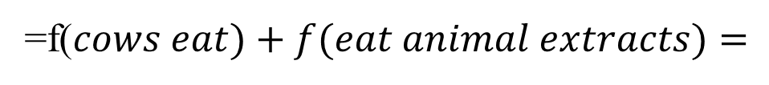
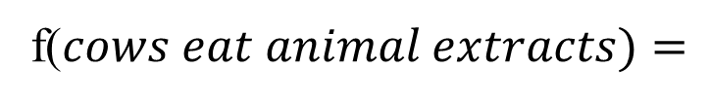
Recursive Linear CDS
eat
Let’s scale up to sentences by recursively applying the model!
VN
VN
cows
extracts
NN
Let’s apply it to RTE
animal
f($cows eat animal extracts)=$
Extremely poor results
=f($cows eat)+f(eat animal extracts)=$
=$A_{VN}\vec{eat}+B_{VN}\vec{cows}+A_{VN}\vec{eat}+B_{VN}f(animal extracts)=$
=$A_{VN}\vec{eat}+B_{VN}\vec{cows}+A_{VN}\vec{eat}+B_{VN}A_{NN}\vec{extracts}+{B_{VN}B}_{NN}\vec{animal}$

Slide 12







Recursive Linear CDS: a closer look
«cows eat animal extracts»
f
$${=2A}_{VN}\vec{eat}+B_{VN}\vec{cows}+B_{VN}A_{NN}\vec{extracts}+{B_{VN}B}_{NN}\vec{animal}$$
$$\vec{v}$$
…
$$∙$$
$$∙$$
$$∙$$
$$\vec{v}∙\vec{u}$$
… evaluating the similarity
$$∙$$
$$\vec{u}$$
$${=2A}_{VN}\vec{eat}+B_{VN}\vec{chickens}+B_{VN}A_{NN}\vec{extracts}+{B_{VN}B}_{NN}\vec{beef}$$
f
«chickens eat beef extracts»

Slide 13
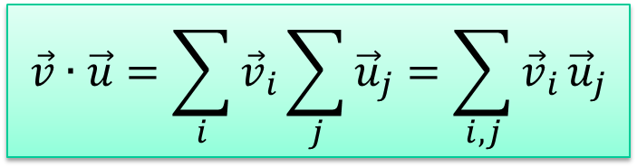
Recursive Linear CDS: a closer look
meaning
meaning
structure
structure
$${=2A}_{VN}\vec{eat}+B_{VN}\vec{cows}+B_{VN}A_{NN}\vec{extracts}+{B_{VN}B}_{NN}\vec{animal}$$
$$\vec{v}$$
?
<1
$$\vec{u}$$
$${=2A}_{VN}\vec{eat}+B_{VN}\vec{chickens}+B_{VN}A_{NN}\vec{extracts}+{B_{VN}B}_{NN}\vec{beef}$$
structure
meaning
$$\vec{v}∙\vec{u}=\sum_{i}{{\vec{v}}_{i}}\sum_{j}{{\vec{u}}_{j}}=\sum_{i,j}{{\vec{v}}_{i}}{\vec{u}}_{j}$$

Slide 14
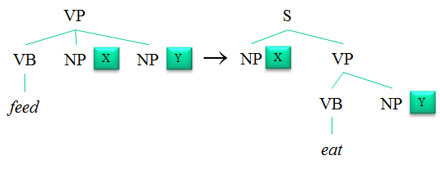
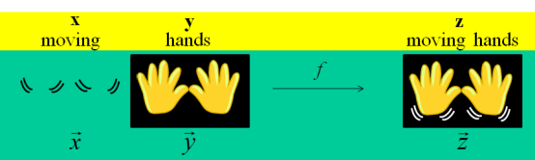
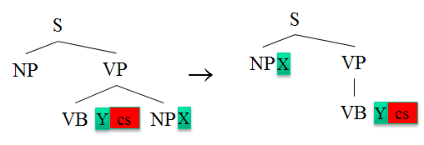
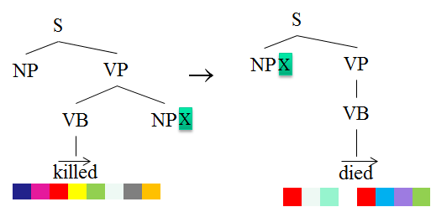

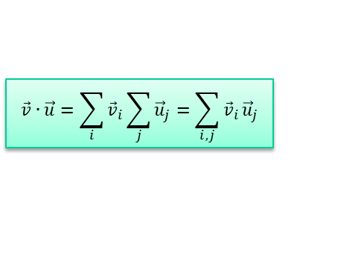
The prequel …
Recognizing Textual Entailment
Distributional Semantics
Feature Spaces of the Rules with Variables
Binary CDS
Recursive CDS
$${B_{VN}B}_{NN}\vec{beef}$$
structure
adding shallow semantics
adding distributional semantics
meaning
$$\vec{v}∙\vec{u}=\sum_{i}{{\vec{v}}_{i}}\sum_{j}{{\vec{u}}_{j}}=\sum_{i,j}{{\vec{v}}_{i}}{\vec{u}}_{j}$$

Slide 15

$$\vec{v}∙\vec{u}=\sum_{i}{{\vec{v}}_{i}}\sum_{j}{{\vec{u}}_{j}}=\sum_{i,j}{{\vec{v}}_{i}}{\vec{u}}_{j}$$
structure
Distributed Tree Kernels

Slide 16







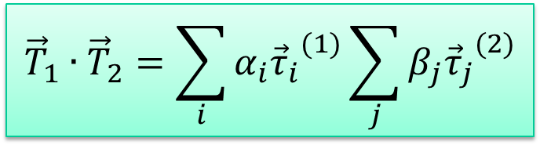
Tree Kernels
$$\vec{v}∙\vec{u}=\sum_{i}{{\vec{v}}_{i}}\sum_{j}{{\vec{u}}_{j}}=\sum_{i,j}{{\vec{v}}_{i}}{\vec{u}}_{j}$$
structure
T
τ_{i}
τ_{j}
S
S
S
NP
VP
NP
VP
NP
VP
NNS
VB
NP
NP
…
NNS
VB
NP
NP
…
NNS
VB
NP
NP
…
Farmers
feed
NNS
NN
NNS
Farmers
cows
animal
extracts
…
…
…
$${\vec{T}}_{1}∙{\vec{T}}_{2}=\sum_{i}{α_{i}{{\vec{τ}}_{i}}^{(1)}}\sum_{j}{β_{j}{{\vec{τ}}_{j}}^{(2)}}$$

Slide 17






Tree Kernels in Smaller Vectors
T
τ_{i}
τ_{j}
S
S
S
NP
VP
NP
VP
NP
VP
NNS
VB
NP
NP
…
NNS
VB
NP
NP
…
NNS
VB
NP
NP
…
Farmers
feed
NNS
NN
NNS
Farmers
cows
animal
extracts
CDS desiderata
- Vectors are smaller
- Vectors are obtained with a Compositional Function
…
…
…
…
…
…

Slide 18

Names for the «Distributed» World
As we are encoding trees in small vectors,
the tradition is distributed structures (Plate, 1994)
Distributed Tree Kernels
(DTK)
Distributed Trees
(DT)
Distributed Tree Fragments
(DTF)
…
…
…

Slide 19
Outline
DTK: Expected properties and challenges
Model:
  Distributed Tree Fragments
  Distributed Trees
Experimental evaluation
Remarks
Back to Compositional Distributional Semantics
Future Work

Slide 20
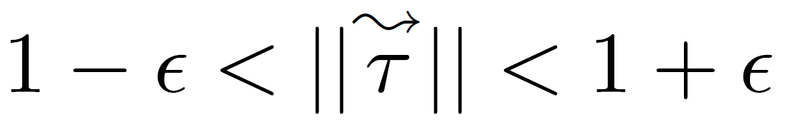
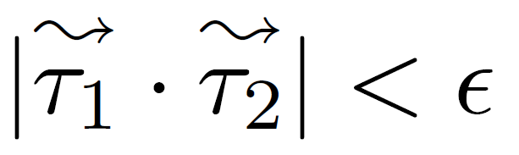

DTK: Expected properties and challenges
Compositionally building Distributed Tree Fragments
Distributed Tree Fragments are a nearly orthonormal base that embeds R^{m} in R^{d}
Distributed Trees can be efficiently computed
DTKs shuold approximate Tree Kernels
Property 1 (Nearly Unit Vectors)
Property 2 (Nearly Orthogonal Vectors)

Slide 21
DTK: Expected properties and challenges
Compositionally building Distributed Tree Fragments
Distributed Tree Fragments are a nearly orthonormal base that embeds R^{m} in R^{d}
Distributed Trees can be efficiently computed
DTKs shuold approximate Tree Kernels
Property 1 (Nearly Unit Vectors)
Property 2 (Nearly Orthogonal Vectors)

Slide 22
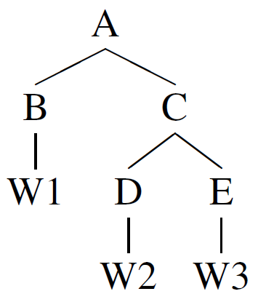


Compositionally building Distributed Tree Fragments
Basic elements
  N a set of nearly orthogonal random vectors for node labels
  ◊ a basic vector composition function with some ideal properties
A distributed tree fragment is the application of the composition function ◊ on the node vectors, according to the order given by a depth first visit of the tree.

Slide 23
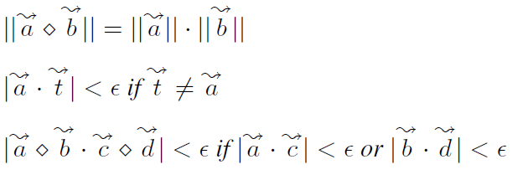
Building Distributed Tree Fragments
Properties of the Ideal function ◊
Non-commutativity with a very high degree k
Non-associativity
Bilinearity
Approximation
we demonstrated DTF are a nearly orthonormal base
Property 1 (Nearly Unit Vectors)
Property 2 (Nearly Orthogonal Vectors)
(see Lemma 1 and Lemma 2 in the paper)
Zanzotto&Dell'Arciprete, Distributed Tree Kernels, Proceedings of ICML, 2012

Slide 24
DTK: Expected properties and challenges
Compositionally building Distributed Tree Fragments
Distributed Tree Fragments are a nearly orthonormal base that embeds R^{m} in R^{d}
Distributed Trees can be efficiently computed
DTKs shuold approximate Tree Kernels
Property 1 (Nearly Unit Vectors)
Property 2 (Nearly Orthogonal Vectors)

Slide 25

Building Distributed Trees
Given a tree T, the distributed representation of its subtrees is the vector:
where S(T) is the set of the subtrees of T
S
S
S(
NP
VP
) = {
S
,
NP
VP
}
NNS
VB
NP
NP
NP
VP
…
Farmers
feed
VB
NP
NP
NNS
VB
NP
NP
NNS
NN
NNS
NNS
Farmers
cows
animal
extracts

Slide 26


Building Distributed Trees
A more efficient approach
N(T) is the set of nodes of T
s(n) is defined as:
if n is terminal
if n→c₁…c_{k}
Computing a Distributed Tree is linear with respect to the size of N(T)

Slide 27
Building Distributed Trees
A more efficient approach
Assuming the ideal basic composition function ◊, it is possible to show that it exactly computes:
(see Theorem 1 in the paper)
Zanzotto&Dell'Arciprete, Distributed Tree Kernels, Proceedings of ICML, 2012

Slide 28
DTK: Expected properties and challenges
Compositionally building Distributed Tree Fragments
Distributed Tree Fragments are a nearly orthonormal base that embeds R^{m} in R^{d}
Distributed Trees can be efficiently computed
DTKs shuold approximate Tree Kernels
Property 1 (Nearly Unit Vectors)
Property 2 (Nearly Orthogonal Vectors)

Slide 29
Experimental evaluation
Concrete Composition Functions Evaluation: How well can concrete composition functions approximate ideal function ◊?
Direct Analysis: How well do DTKs approximate the original tree kernels (TKs)?
Task-based Analysis: How well do DTKs perform on actual NLP tasks, with respect to TKs?
Vector dimension = 8192

Slide 30


Towards the reality: Approximating ◊
◊ is an ideal function!
Proposed approximations:
  Shuffled normalized element-wise product
  Shuffled circular convolution
It is possible to show that properties of ◊ statistically hold for the two approximations

Slide 31
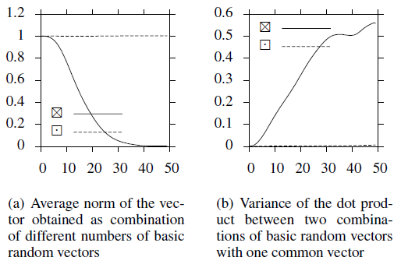
Empirical Evaluation of Properties
OK
OK
?
?
Non-commutativity
Distributivity over the sum
Norm preservation
Orthogonality preservation

Slide 32
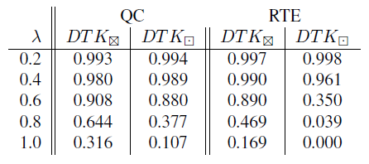
Direct Analysis for z
Spearman’s correlation between DTK and TK values
Test trees taken from QC corpus and RTE corpus

Slide 33
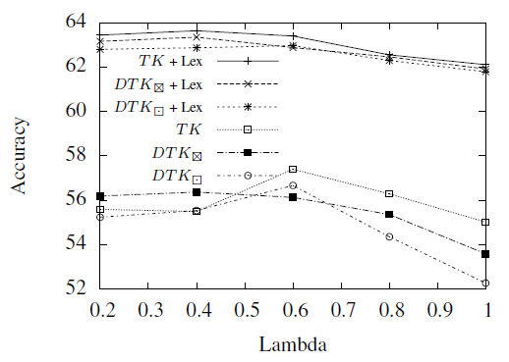
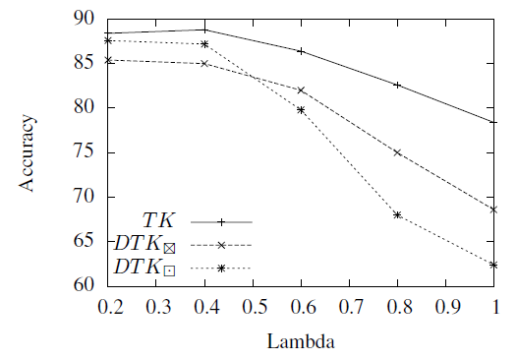
Task-based Analysis for x
Question Classification
Recognizing Textual Entailment

Slide 34
Remarks
Distributed Tree Kernels
(DTK)
approximate Tree Kernels
Distributed Trees
(DT)
Distributed Tree Fragments
(DTF)
can be efficiently computed
are a nearly orthonormal base that embeds R^{m} in R^{d}
…
…
…

Slide 35
Side effect
Tree kernels (TK) (Collins & Duffy, 2001) have quadratic time and space complexity.
Current techniques control this complexity by:
  exploiting of some specific characteristics of trees (Moschitti, 2006)
  selecting subtrees headed by specific node labels (Rieck et al., 2010)
  exploiting dynamic programming on the whole training and application sets of instances (Shin et al.,2011)
Our Proposal
Encoding trees in small vectors
(in line with distributed structures (Plate, 1994))

Slide 36
Structured Feature Spaces:
Dimensionality Reduction
T
τ_{i}
τ_{j}
S
S
S
NP
VP
NP
VP
NP
VP
NNS
VB
NP
NP
…
NNS
VB
NP
NP
…
NNS
VB
NP
NP
…
Farmers
feed
NNS
NN
NNS
Farmers
cows
animal
extracts
Traditional Dimensionality Reduction Techniques
Singular Value Decomposition
Random Indexing
Feature Selection
…
…
Not applicable
…
…
…
…

Slide 37
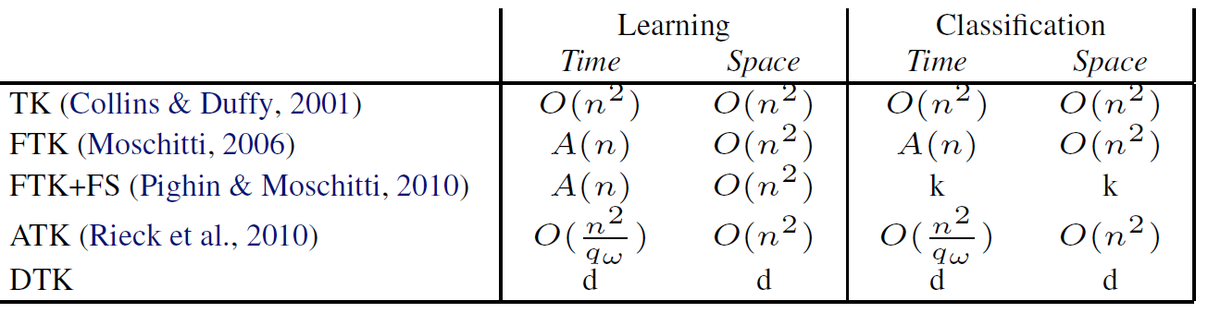
Computational Complexity of DTK
n size of the tree
k selected tree fragments
q_{ω} reducing factor
O(.) worst-case complexity
A(.) average-case complexity

Slide 38
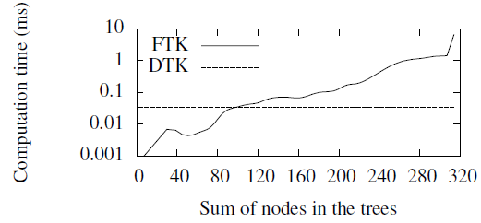
Time Complexity Analysis
DTK time complexity is independent of the tree sizes!

Slide 39
Outline
DTK: Expected properties and challenges
Model:
  Distributed Tree Fragments
  Distributed Trees
Experimental evaluation
Remarks
Back to Compositional Distributional Semantics
Future Work

Slide 40
Towards Distributional Distributed Trees
Distributed Tree Fragments
  Non-terminal nodes n: random vectors
  Terminal nodes w: random vectors
Distributional Distributed Tree Fragments
  Non-terminal nodes n: random vectors
  Terminal nodes w: distributional vectors
Caveat: Property 2
Random vectors are nearly orthogonal
Distributional vectors are not
Zanzotto&Dell‘Arciprete, Distributed Representations and Distributional Semantics, Proceedings of the ACL-workshop DiSCo, 2011

Slide 41
Experimental Set-up
Task Based Comparison:
  Corpus: RTE1,2,3,5
  Measure: Accuracy
Distributed/Distributional Vector Size: 250
Distributional Vectors:
  Corpus: UKWaC (Ferraresi et al., 2008)
  LSA: applied with k=250
Zanzotto&Dell‘Arciprete, Distributed Representations and Distributional Semantics, Proceedings of the ACL-workshop DiSCo, 2011

Slide 42
Accuracy Results
Zanzotto&Dell‘Arciprete, Distributed Representations and Distributional Semantics, Proceedings of the ACL-workshop DiSCo, 2011

Slide 43



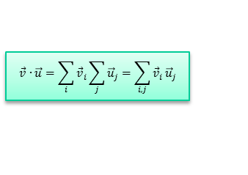
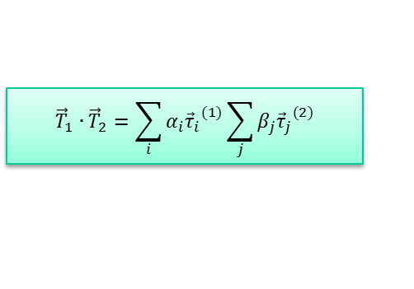
The plot so far…
Recognizing Textual Entailment
Distributional Semantics
Tree Kernels
Feature Spaces of the Rules with Variables
$${\vec{T}}_{1}∙{\vec{T}}_{2}=\sum_{i}{α_{i}{{\vec{τ}}_{i}}^{(1)}}\sum_{j}{β_{j}{{\vec{τ}}_{j}}^{(2)}}$$
Binary CDS
Recursive CDS
$${B_{VN}B}_{NN}\vec{beef}$$
adding shallow semantics
adding distributional semantics
structure
meaning
$$\vec{v}∙\vec{u}=\sum_{i}{{\vec{v}}_{i}}\sum_{j}{{\vec{u}}_{j}}=\sum_{i,j}{{\vec{v}}_{i}}{\vec{u}}_{j}$$
Distributed Tree Kernels
(DTK)
meaning

Slide 44
Future Work
Distributed Tree Kernels
  Applying the method to other tree and graph kernels
  Optimizing the code with GPU programming (CUDA)
  Using Distributed Trees for different applications
    for indexing structured information for Syntax-aware Information Retrieval or
    for indexing structured information for XML Information Retrieval
    …
Compositional Distributional Semantics
  Using the insight gained with DTKs to better understand how to produce syntax-aware CDS models (see preliminary investigation in Zanzotto&Dell’Arciprete, DISCO 2011)

Slide 45
Credits
Lorenzo Dell’Arciprete
Marco Pennacchiotti
Alessandro Moschitti
Yashar Mehdad
Ioannis Korkontzelos
Code:
http://code.google.com/p/distributed-tree-kernels/
SEMEVAL TASK 5: EVALUATING PHRASAL SEMANTICS
http://www.cs.york.ac.uk/semeval-2013/task5/

Slide 46


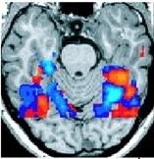
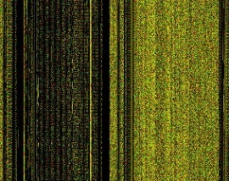
Brain&Computer
Distributed Tree Kernels
Compositional Distributional Semantics
S
S
C
VP
VP
F
⊗
VB
NP
NP
N
VB
NP
NP

Slide 48
If you want to read more…
Distributed Tree Kernels
Zanzotto, F. M. & Dell'Arciprete, L. Distributed Tree Kernels, Proceedings of International Conference on Machine Learning, 2012
Tree Kernels and Distributional Sematics
Mehdad, Y.; Moschitti, A. & Zanzotto, F. M. Syntactic/Semantic Structures for Textual Entailment Recognition, Human Language Technologies: The 2010 Annual Conference of the North American Chapter of the Association for Computational Linguistics, 2010
Compositional Distributional Semantics
Zanzotto, F. M.; Korkontzelos, I.; Fallucchi, F. & Manandhar, S. Estimating Linear Models for Compositional Distributional Semantics, Proceedings of the 23rd International Conference on Computational Linguistics (COLING), 2010
Distributed and Distributional Tree Kernels
Zanzotto, F. M. & Dell'arciprete, L. Distributed Representations and Distributional Semantics, Proceedings of the ACL-HLT 2011 workshop on Distributional Semantics and Compositionality (DiSCo), 2011
SEMEVAL TASK 5: EVALUATING PHRASAL SEMANTICS
http://www.cs.york.ac.uk/semeval-2013/task5/

Slide 49
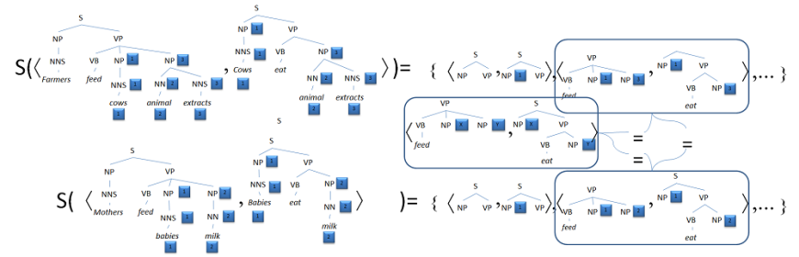
My first life
Learning Textual Entailment Recognition Systems
Initial Idea
Zanzotto, F. M. & Moschitti, A. Automatic learning of textual entailments with cross-pair similarities, ACL-44: Proceedings of the 21st International Conference on Computational Linguistics and the 44th annual meeting of the Association for Computational Linguistics, 2006
First refinement of the algorithm
Moschitti, A. & Zanzotto, F. M. Fast and Effective Kernels for Relational Learning from Texts, Proceedings of 24th Annual International Conference on Machine Learning, 2007
Adding shallow semantics
Pennacchiotti, M. & Zanzotto, F. M. Learning Shallow Semantic Rules for Textual Entailment, Proceeding of International Conference RANLP - 2007, 2007
A comprehensive description
Zanzotto, F. M.; Pennacchiotti, M. & Moschitti, A. A Machine Learning Approach to Textual Entailment Recognition, NATURAL LANGUAGE ENGINEERING, 2009

Slide 50
My first life
Learning Textual Entailment Recognition Systems
Adding Distributional Semantics
Mehdad, Y.; Moschitti, A. & Zanzotto, F. M. Syntactic/Semantic Structures for Textual Entailment Recognition, Human Language Technologies: The 2010 Annual Conference of the North American Chapter of the Association for Computational Linguistics, 2010
A valid kernel with an efficient algorithm
Zanzotto, F. M. & Dell'Arciprete, L. Efficient kernels for sentence pair classification, Conference on Empirical Methods on Natural Language Processing, 2009
Zanzotto, F. M.; Dell'arciprete, L. & Moschitti, A. Efficient Graph Kernels for Textual Entailment Recognition, FUNDAMENTA INFORMATICAE
Applications
Zanzotto, F. M.; Pennacchiotti, M. & Tsioutsiouliklis, K. Linguistic Redundancy in Twitter, Proceedings of 2011 Conference on Empirical Methods on Natural Language Processing (EmNLP), 2011
Extracting RTE Corpora
Zanzotto, F. M. & Pennacchiotti, M. Expanding textual entailment corpora from Wikipedia using co-training, Proceedings of the COLING-Workshop on The People's Web Meets NLP: Collaboratively Constructed Semantic Resources, 2010
Learning Verb Relations
Zanzotto, F. M.; Pennacchiotti, M. & Pazienza, M. T. Discovering asymmetric entailment relations between verbs using selectional preferences, ACL-44: Proceedings of the 21st International Conference on Computational Linguistics and the 44th annual meeting of the Association for Computational Linguistics

Slide 51
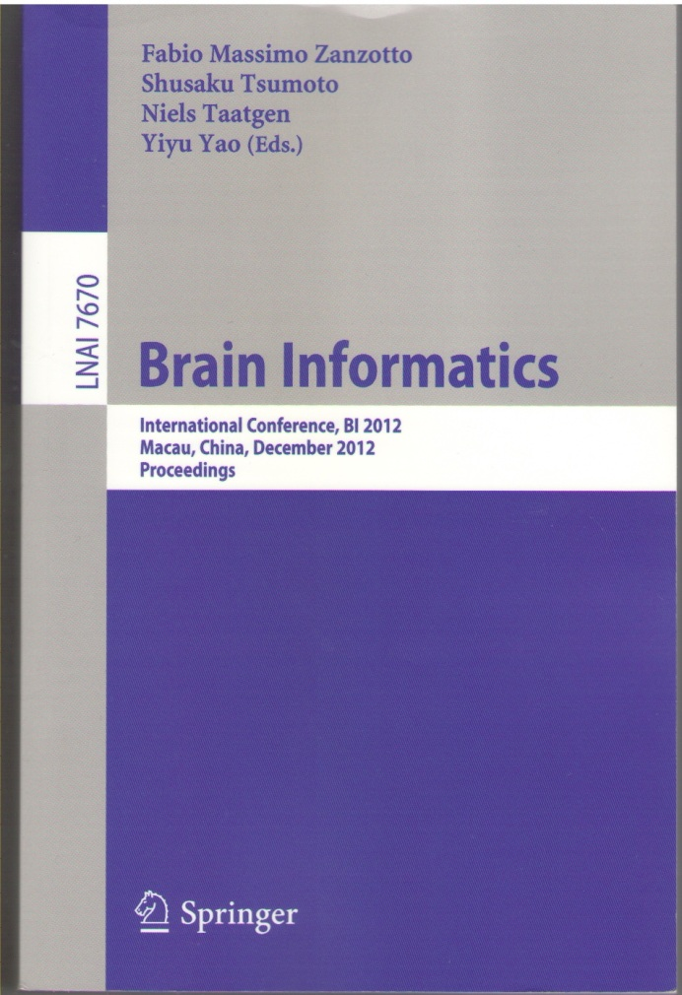
My second life
Parallels between Brains and Computers
Zanzotto, F. M. & Croce, D. Comparing EEG/ERP-like and fMRI-like Techniques for Reading Machine Thoughts, BI 2010: Proceedings of the Brain Informatics Conference - Toronto, 2010
Zanzotto, F. M.; Croce, D. & Prezioso, S. Reading what Machines "Think": a Challenge for Nanotechnology, Joint Conferences on Avdanced Materials, 2009
Zanzotto, F. M. & Croce, D. Reading what machines "think", BI 2009: Proceedings of the Brain Informatics Conference - Bejing, China, October 2009
Prezioso, S.; Croce, D. & Zanzotto, F. M. Reading what machines "think": a challenge for nanotechnology, JOURNAL OF COMPUTATIONAL AND THEORETICAL NANOSCIENCE, 2011
Zanzotto, F. M.; Dell'arciprete, L. & Korkontzelos, Y. Rappresentazione distribuita e semantica distribuzionale dalla prospettiva dell'Intelligenza Artificiale, TEORIE & MODELLI, 2010

Slide 52
Quick background on Supervised Machine Learning
Instance
x_{i}
Classifier
y_{i}
x_{i}
Instance in a feature space
Learnt Model
{(x₁,y₁)
(x₂,y₂)
…
(x_{n},y_{n})}
Training Set
Learner

Slide 53
Quick background on Supervised Machine Learning
Some Machine Learning Methods exploit the distance between instances in the feature space
Instance
x_{i}
Classifier
y_{i}
x_{j}
x_{i}
Instance in a feature space
K(x₁,x₂)
Learnt Model
x_{j}
For these so-called Kernel Machines, we can use the Kernel Trick:
  «define the distance K(x₁ , x₂) instead of directly representing instances in the feature space»

Slide 54
Thank you for the attention

