Slide 1
MIT AppInventor: Creazione di App su Android
Fabio Massimo Zanzotto

Slide 2
Cosa vedremo nelle lezioni
Sfida: Creazione di App su Android
Mattoni base
Algoritmo, modello per risolvere problemi
Rappresentazione dell’informazione
Architettura del calcolatore
Costruzioni sovrastanti
Sistema operativo
Reti di calcolatori e WWW
Programmi applicativi

Slide 3
Una lezione: Hands On (mani in pasta)
Alcune slides sono una traduzione presa da
App Inventor, Barb Ericson (presentazione)

Slide 4
MIT’s AppInventor: Storia
Rilasciato 15 Dicembre 2010 da Google
Basato su esperienza precedenti di educazione alla programmazione
Seymour Papert – Logo and constructionism
Usa la libreria Open Blocks Java del MIT
E’ simile a Scratch del MIT
E’ stato preso in casa dall’MIT il 1 Gennaio 2012
Notes:
You will need to download your projects to your machine before Dec 31, 2011. You can do this from the "My Projects" page.

Slide 5
MIT’s AppInventor: Che cos’è?
Piattaforma gratuita per lo sviluppo di apps per Google Android OS
Tutti i dati sono su un server remoto (Cloud computing)
La piattaforma è composta da due parti:
Designer (progettatore): dove si può produrre l’interfaccia dell’app e si possono aggiungere i componenti visibili e non visibili (non-visible components)
Blocks Editor (programmatore): dove si può descrivere il comportamento dei componenti

Slide 6
MIT’s App Inventor

Slide 7
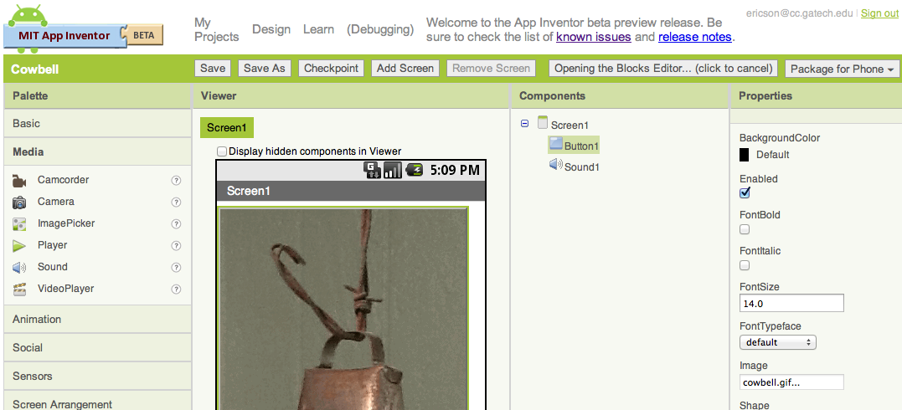
Designer
Funziona come una applicazione web (evitare IE)
Notes:
In IE you may have to set the width and height for a picture to get it to correctly show.

Slide 8
Parti del Designer
Palette
Visible and non-visible
components
Viewer
Mostra l’interfaccia attuale dell'app
Components
Nomi e gerarchia dei componenti
Properties
Descrive e controlla le proprietà dei componenti

Slide 9
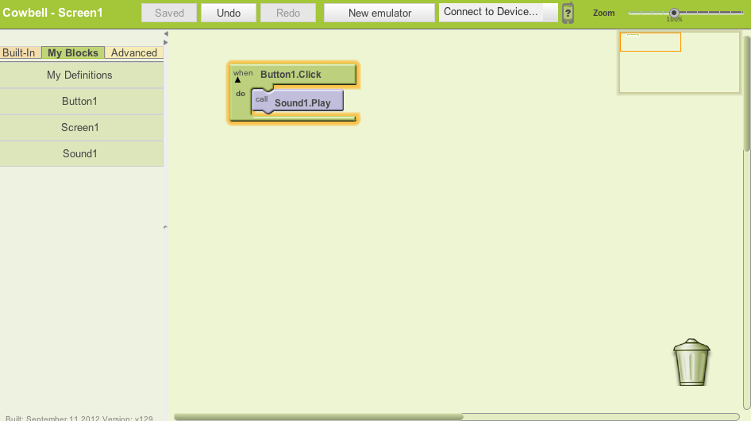
Blocks Editor
Lavora utilizzando il Java Locale ma lavora sulla cloud
Avvia un emulatore
Connette all’emulatore o al cellulare
Prendere i blocchi da qui
Sposta i blocchi

Slide 10
Come cominciare
Cosa istallare
http://beta.appinventor.mit.edu/learn/setup/index.html
Install Java 6 or above
Install the App Inventor Setup Software
Install phone drivers if you want to use phones
Setup your phone
Apprendere App Inventor http://appinventor.mit.edu/explore/learn.html
Fare Login al sito (con un google account) http://beta.appinventor.mit.edu/

Slide 11
Creare un nuovo progetto
Click sul bottone New
Scivere il nome del progetto (senza spazi)
Il nome del Progetto diventa il nome dell’app "Cowbell"

Slide 12
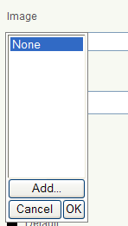
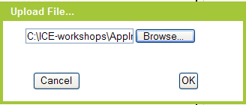
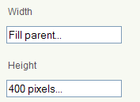
Come mettere un bottone con una immagine
Drag out a Button from the Basic palette and drop it on Screen1
In the properties area
Set the image
click on None under Image.
Click on Add and an Upload File window will appear
Click on Browse and find the "cowbell.gif" file
Then click OK
Remove the default text
Set the width and height if needed
On some browsers
c
c

Slide 13
Block Editor
Controllare il comportamento dei componenti
Abbiamo a disposizione per ogni componente dei pezzi di puzzle
Comportamento per eventi
Nome Componte
Evento

Slide 14
Block Editor
Azioni sui componenti
Nome Componte
Azione
Sotto Azione

Slide 15
Block Editor
Azioni sulle proprietà dei componenti
Nome Componte
Valore Finale
Azione
Proprietà

Slide 16
Block Editor
Valori finali

Slide 17
Block Editor
Combinazione dei pezzi di puzzle

Slide 18
Creiamo la prima app
Cambiatore di colore per un pulsante

Slide 19
Block editor
Le variabili: un posto dove mettere i valori
Azioni sulle variabili:
Usa il valore
Metti un valore

Slide 20
Seconda App
Costruiamo una app che gonfia un palloncino pigiando un bottone

Slide 21
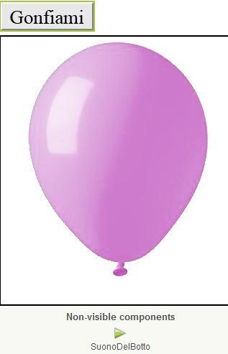
Seconda App
Designer: Palloncino

Slide 22
Seconda App
Variabile
Come usare la variabile per dimensionare il palloncino
Come variare la variabile

Slide 23
Seconda App

Slide 24
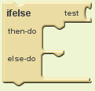
Alcuni «modi» di dire
Il «modo di dire»
se…allora…altrimenti

Slide 25
Terza App
Palloncino che se si gonfia troppo scoppia e ritorna piccolo

Slide 26
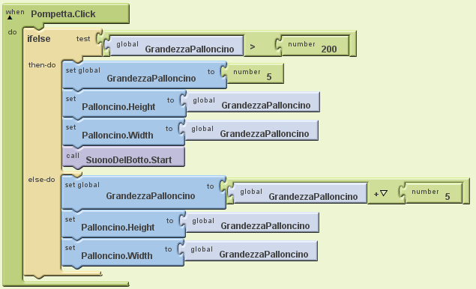
Terza App

Slide 28
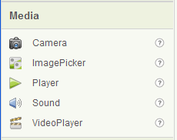
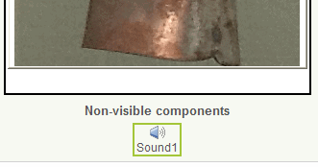
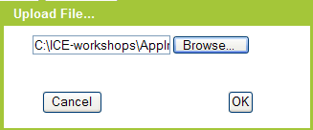
Come mettere un suono
Drag out a Sound from the Media palette
It isn't visible on the screen but will be shown in the Non-visible components
Click on None under the Source property
Click on Add
Click on Browse and find "cowbell.wav"
Click on OK

Slide 29
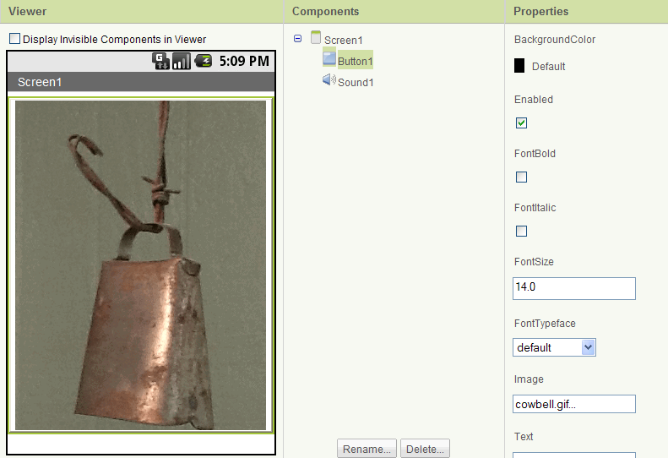
Current User Interface

Slide 30
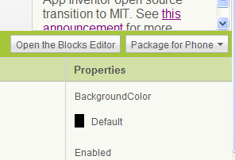
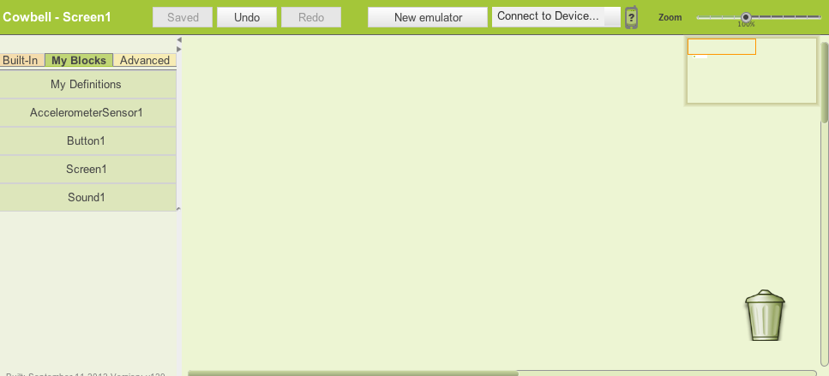
Bring up the Blocks Editor
Click on the Open the Blocks Editor button
This will download the Java Web Start file
Depending on the browser you may have to click on Save and then click on the downloaded file or click on Open

Slide 31
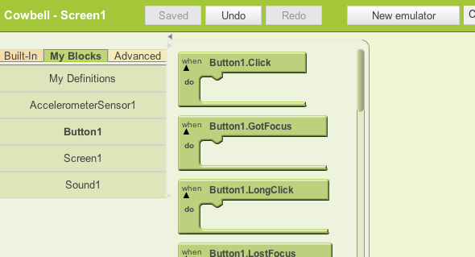
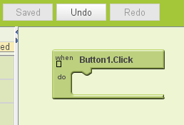
Adding an Event Handler
An event handler responds when an event occurs
Like when a button is clicked
Click on My Blocks > Button1
Drag out a when Button1.Click block and drop it in the center area

Slide 32
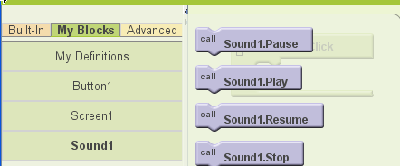
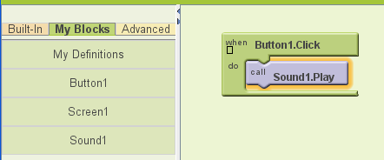
Playing the Sound
Click on MyBlocks > Sound1
Drag out a call Sound1.Play block and drop it inside the when Button1.Click
When you click the button the sound will play

Slide 33
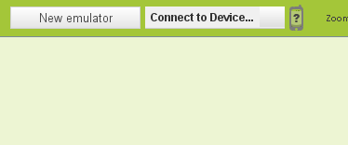
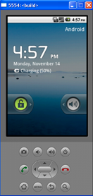
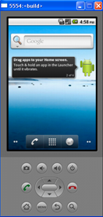
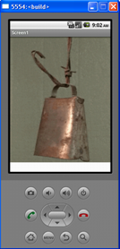
Showing the App on the Emulator
Click on the New emulator button in the Blocks Editor
Wait for the emulator
Wait till it looks like a phone (several minutes)
Unlock by clicking on the lock and dragging to the right
Click on Connect to Device and select the emulator
The app will download to the emulator and show
Notes:
The emulator has limited capability. You can't use the accelerometer, camera, GPS, or send or receive text messages with it.
The emulator can display images, play sounds, detect touch (click) and drag (click and drag).

Slide 34
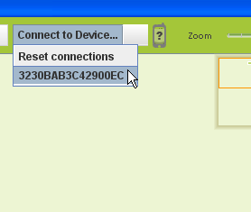
Downloading to Phone
Connect the phone with the USB cable
The first time you may have to install device drivers
http://www.appinventorbeta.com/learn/setup/
Click on Connect to Device
Click on the phone id

Slide 35
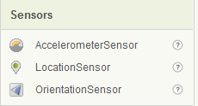
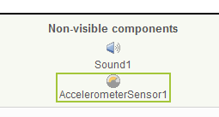
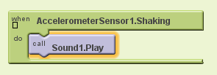
Play Sound While Shaking Phone
In the Designer drag out an AccelerometerSensor from the Sensors palette
It will show under Non-visible components
In the Blocks Editor click on My Blocks > AccelerometerSensor1 and drag out a when AccelerometerSensor1.Shaking
Add a call Sound1.Play from MyBlocks > Sound1
Notes:
This will not work on the emulator, just on the phone.

Slide 36
Other Ideas
Set the screen orientation property on Screen1 to portrait
So it won't switch to landscape when you shake the phone
Create a similar app with a different image and sound
Like a picture of hands clapping and a clapping sound for people with one hand.
Create several buttons with small images and associated sounds

Slide 37
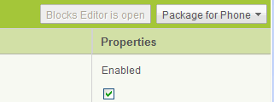
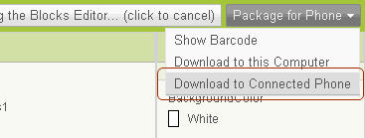
Package for Phone
Your app will work as long as the phone is connected
To have your app work after you disconnect the phone
In the Designer click on Package for Phone
Click Download to Connected Phone

Slide 38
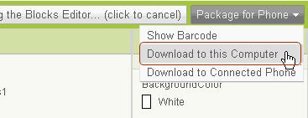
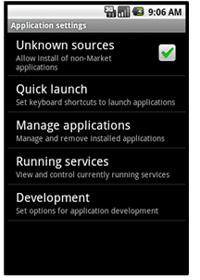
Sharing an App with Others
In Designer
Click Package for Phone
Click Download to this Computer
This will download a file ending in .apk to your computer
Upload the file to the web and tell others the url
They can use their phone's browser to go to the url and download the app
They will need to allow Unknown Sources in the Application settings on their phone

Slide 39
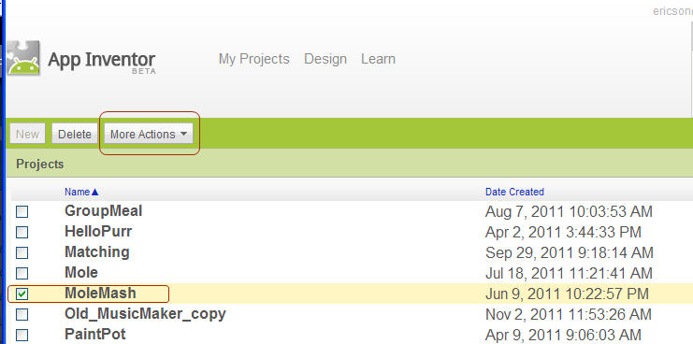
Sharing a Project with Others
Go to My Projects
Check the app to share
Click on "More Actions" and then "Download Source"
This will download a file to your computer that ends in .zip
Others can click on "More Actions" and "Upload Source" to get project

Slide 40
Computing Concepts
Event driven programming
Variables
Conditionals
Random Numbers
Procedures and parameters
Creating your own blocks
Lists
Iteration (Loops)
Recursion
User Interfaces
Model, View, Controller

Slide 41
What else can you do?
Create games
Image sprites – collision detection, timers
Use the camera and then draw on the picture
Canvas
Create a quiz
Using lists
Automatically respond to text messages
Use text-to-speech to read a message
Store data on the phone
Use the GPS to remember where your car is
Open Google maps to a particular URI
Play notes and record what you play
Create a list of people to automatically text
Create a remote control for your LEGO NXT robot
Use a barcode scanner and get info from websites with web data APIs

Slide 42
Tips and Techniques
You can copy and paste a set of blocks
Control C and V on windows
You can just type a number or Boolean value
The correct block will be created
When you right click on a block you can:
Add a comment
Deactivate a block
Watch a variable
Execute a block immediately

Slide 43
Resources
Our distance learning site
http://ice-web.cc.gatech.edu/dl/
Official tutorials
http://beta.appinventor.mit.edu/learn/tutorials/index.html
College course
http://turing.cs.trincoll.edu/~ram/cpsc110/schedule.html
On-line draft of a book and example code
http://www.appinventor.org/in-1
http://examples.oreilly.com/0636920016632/

